Slide 1


PRATHYUSHA ENGINERING COLLEGE DEPARTMENT OF COMPUTER SCIENCE AND ENGINEERING AI VIRTUAL MOUSE USING HAND GESTURE RECOGNITION
Internal Guide
name:MS.MEENA
designation:
ASSISTANT PROFESSOR
Team members:
K . SUPRIYA 111420104049
D . YOGITHA 111420104016

Slide 2
AI VIRTUAL MOUSE USING HAND GESTURE RECOGNITION

Slide 3
OBJECTIVE
The objectives of the AI virtual mouse using gesture recognition mini project can be stated as follows:
❖ Gesture-Based Mouse Control: Develop a system that allows users to control the computer mouse using hand gestures captured from a camera, eliminating the need for physical mouse and keyboard inputs.
❖ Real-Time Hand Tracking: Implement computer vision algorithms to accurately detect and track the user's hand in real-time, ensuring smooth and responsive mouse control.

Slide 4
PROBLEM STATMENT
The traditional method of controlling the computer mouse using physical input devices, such as a mouse and keyboard, may pose challenges for individuals with limited mobility or those seeking a more intuitive and hands-free interaction. Additionally, the conventional mouse control can be cumbersome in certain scenarios, such as during presentations or when working in a touchless environment.
To address these issues, the problem at hand is to develop an AI virtual mouse system using gesture recognition. The system should enable users to control the computer mouse cursor through hand gestures captured from a camera. By recognizing specific gestures and translating them into mouse movements and actions, the system aims to provide an alternative, intuitive, and hands-free method of controlling the computer.

Slide 5
EXISTING SYSTEM
There were projects like screen touch, using mouse we can control cursor. By using open cv and media pipe we automated mouse cursor with fingers.
DISADAVANTAGES
❖ There will always be limitations of the mouse as the mouse is a hardware input device and there can be some problems like mouse click not functioning properly.
❖ The mouse is a hardware device like any other physical object even the mouse will have a durability time within which is functional and after its durability time we have to change the Mouse.

Slide 6
PROPOSED SYSTEM
The proposed system for the AI virtual mouse using gesture recognition mini project can be outlined as follows:
Advantages:
❏ Virtual Mouse using Hand gesture recognition allows users to control mouse with the help of hand gestures.
❏ System’s webcam is used for tracking hand gestures.
❏ Computer vision techniques are used for gesture recognition. OpenCV consists of a package called video capture which is used to capture data from a live video.
❏ main thing we need to identify are the applications the model is going to develop so the development of the mouse movement without using the system mouse.

Slide 7
TECHNOLOGY USED
VSCODE
❖ AUTOPY
❖ OPEN CV
❖ MEDIAPIPE
❖ PYTHON – PROGRAMMING LANGUAGE

Slide 8
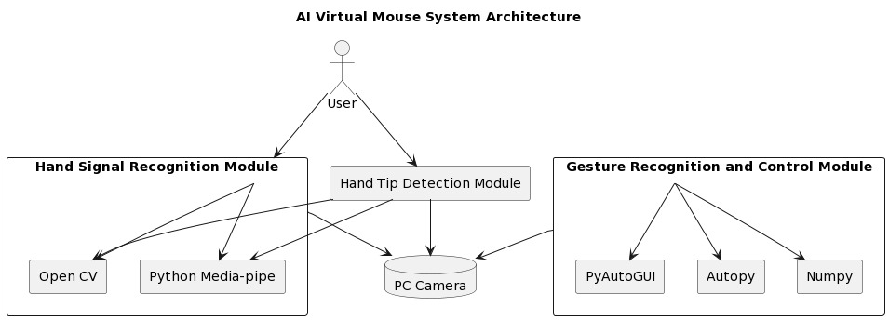
SYSTEM ARCHITECTURE

Slide 9
FUTURE ENCHANMENT
The proposed AI virtual mouse has some limitations such as the accuracy of the right click mouse function and also the model has some difficulties in executing clicking and dragging to select the text. These are some of the limitations of the proposed AI virtual mouse system, and these limitations will be overcome in our future work.
Furthermore, the proposed method can be developed to handle the keyboard functionalities along with the mouse functionalities virtually which is another future scope of Human-Computer Interaction (HCI).

Slide 10
CONCLUSION
The main objective of the AI virtual mouse system is to control the mouse cursor functions by using the hand gestures instead of using a physical mouse. The proposed system can be achieved by using a webcam or a built-in camera which detects the hand gestures and hand tip and processes these frames to perform the particular mouse functions.
From the results of the model, we can come to a conclusion that the proposed AI virtual mouse system has performed very well and has a greater accuracy compared to the existing models and also the model overcomes most of the limitations of the existing systems. Since the proposed model has greater accuracy, the AI virtual mouse can be used for real-world applications, and also, it can be used to reduce the spread of COVID-19, since the proposed mouse system can be used virtually using hand gestures without using the traditional physical mouse.

Slide 11
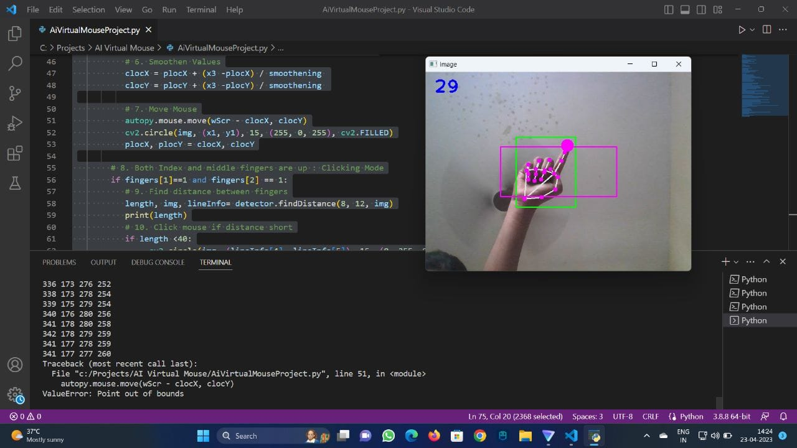
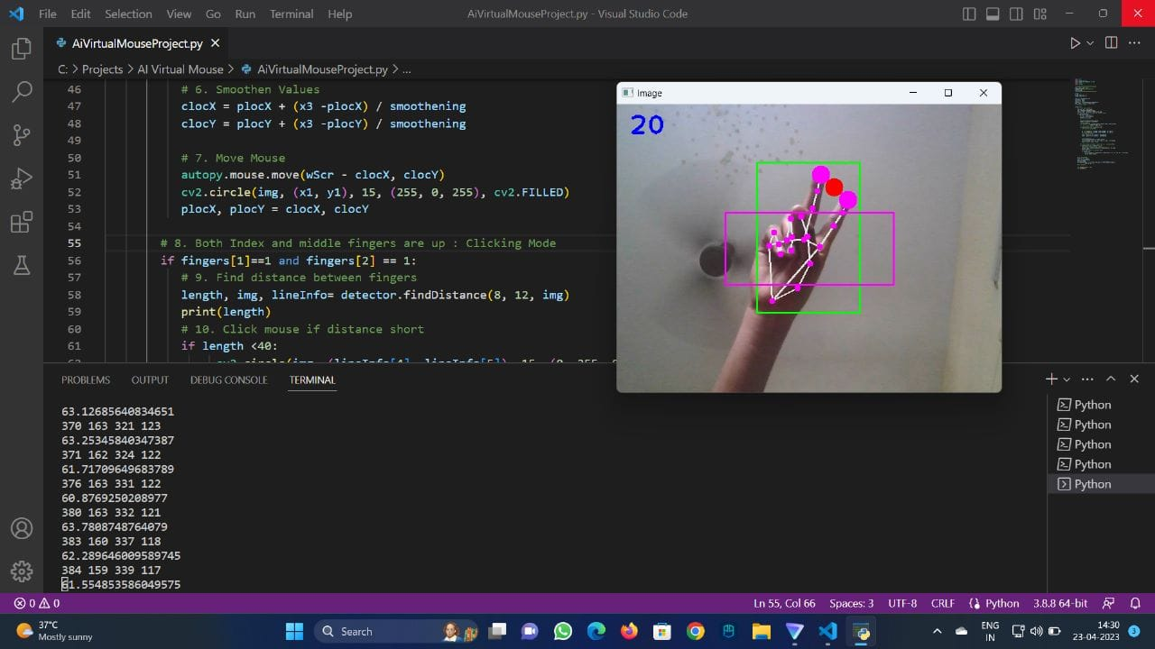
OUTPUT SCREENSHOTS

Slide 12
REFERENCES
J. Katona, “A review of human–computer interaction and virtual reality research fields in cognitive Info Communications,” Applied Sciences, vol. 11, no. 6, p. 2646, 2021.
D. L. Quam, “Gesture recognition with a Data Glove,” IEEE Conference on Aerospace and Electronics, vol. 2, pp. 755–760, 1990.
D.-H. Liou, D. Lee, and C.-C. Hsieh, “A real time hand gesture recognition system using motion history image,” in Proceedings of the 2010 2nd International Conference on Signal Processing Systems, IEEE, Dalian, China, July 2010.
S. U. Dudhane, “Cursor control system using hand gesture recognition,” IJARCCE, vol. 2, no. 5, 2013.

Slide 13
THANK YOU!

